Slide 1





Oasis: Pooling PCIe Devices Over CXL to Boost Utilization
Yuhong Zhong
Daniel S. Berger
Pantea Zardoshti
Enrique Saurez
Jacob Nelson
Dan R. K. Ports
Antonis Psistakis
Joshua Fried
Asaf Cidon
Columbia University Microsoft University of Washington UIUC MIT CSAIL
Notes:
Hello everyone. My name is Yuhong. I’m a PhD student at Columbia unversity. Today I’m going to talk about our work: Oasis, pooling PCIe devices over CXL to boost utilization. This is a collaboration with my coauthors from microsoft, university of washington, UIUC and MIT CSAIL.

Slide 2
Executive Summary
Pooling memory with CXL^{[1,2]}
Net memory cost savings despite minor CXL device costs
Memory
(25-50%)
Other
⚠️ Low util
Oasis: Pooling PCIe devices over CXL
Near-zero extra costs
TCO savings, higher utilization
PCIe fault tolerance
NIC & SSD
(20-40%)
✅
✅
⚠️ Low util
✅
CPU Server CapEx
[1] Li et al., Pond: CXL-Based Memory Pooling Systems for Cloud Platforms, ASPLOS ’23
[2] Berger et al., Octopus: Scalable Low-Cost CXL Memory Pooling, Microsoft Technical Report
Notes:
To give quick overview, both memory and PCIe devices such as NIC and SSD account for a large percentage of server CapEx, but they both have low utilization.
Prior work shows that, by pooling memory across multiple servers with CXL, the server memory costs can be reduced despite the minor CXL device costs.
In this work, we argue that, the same CXL investment for memory pooling can unlock PCIe device pooling at *near-zero extra cost*
We build Oasis, the first system to pool PCIe devices across servers over CXL memory pools.
Oasis delivers TCO savings, higher PCIe utilization, and device fault tolerance

Slide 3
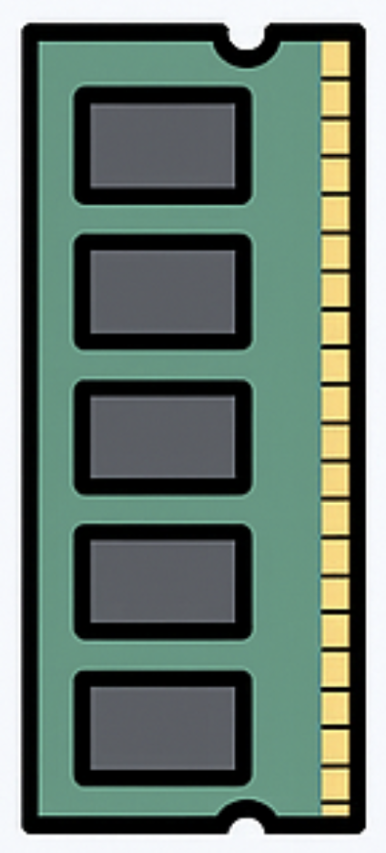
Lots of Work on CPU and Memory Utilization
CPU
PULSE [ASPLOS ’25], Coach [ASPLOS ’25], Memstrata [OSDI ’24], MTM [EuroSys ’24], Pond [ASPLOS ’23], Aggregate VM [EuroSys ’23], TPP [ASPLOS ’23], Syrup [SOSP ’21], HarvestVM [OSDI ’20],
AIFM [OSDI ’20], Shenango [NSDI ’19], LegoOS [OSDI ’18], ...
Notes:
Improving the CPU and memory utilization is one of the central topics of systems research.
There are lots of work that improves CPU and memory utilization by using memory disaggregation, CPU and memory oversubscription, and better scheduling.

Slide 4
PCIe Devices Are Underutilized at Peak
Main Problem: Improve PCIe Utilization
CPU
FPGA
NIC
SSD
Smart
SSD
15% Used
46% Used
20-40% of CapEx, 26% of OpEx/Power
Reidys et al., Coach: Exploiting Temporal Patterns for All-Resource Oversubscription in Cloud Platforms, ASPLOS ‘25
Wang et al., Designing Cloud Servers for Lower Carbon, ISCA ‘24
Notes:
However, PCIe devices are also largely underutilized in CPU clusters, even at peak load.
For example, we find that, in datacenters, the peak NIC bandwidth utilization is lower than 15% in aggregate. This is mainly because datacenters often oversubscribe the uplink bandwidth of top-of-rack switches by a 3:1 ratio.
Besides NIC, recent work from Azure also shows that 64% of SSD capacity cannot be allocated even at the peak because hosts do not have extra CPU or memory resources to run more workloads.
Note that we conservatively report the peak utilization. The average utilization is often single digit.
Despite being largely underutilized, NIC and SSD account for 20-40% of server capex and 26% of server power consumption in CPU clusters.
Besides NIC and SSD, accelerators with niche use cases, such as FPGA and SmartSSD, often have very low adoption rate and even lower utilization.
In this work, we focus on improving the utilization of PCIe devices in CPU clusters.

Slide 5
Overprovisioning Causes Low Utilization
Host A
Host B
NIC
SSD
NIC
SSD
PCIe resources are overprovisioned for peak demand per-host
Idle resources cannot be used by other hosts
Redundant devices are provisioned per-host for availability
Notes:
The key reason that causes the low utilization is the unbalanced resource demand across different hosts.
Hosts in the same datacenter row often have the same set of hardware components.
However, each host runs a different set of workloads, which require different combinations of resources.
When provisioning PCIe devices to each host, datacenter operators need to provision resources based on the per-host peak demand at each dimension.
Note that idle PCIe device at one host cannot be used by other hosts
In addition, to handle device failures, it is common to provision redundant devices. However, since it is unlikely that most hosts experience device failure, the redundancy also lead to the overall underutilization.

Slide 6
Pooling PCIe to Boost Utilization
Host A
Host B
NIC
SSD
NIC
SSD
Notes:
To avoid overprovisioning PCIe resources for each host, one promising solution is to pool PCIe devices so that they are shared across multiple hosts

Slide 7
Pooling PCIe to Boost Utilization
Host A
Host B
PCIe Device Pool
NIC
SSD
NIC
SSD
Pooling improves PCIe utilization and ensures fault tolerance
Notes:
To avoid overprovisioning PCIe resources for each host, one promising solution is to pool PCIe devices so that they are shared across multiple hosts
By allowing hosts to share the same set of PCIe devices, pooling improves PCIe device utilization.
Pooling also ensures fault tolerance as hosts can failover between devices
But, how can we implement PCIe pooling today?

Slide 8
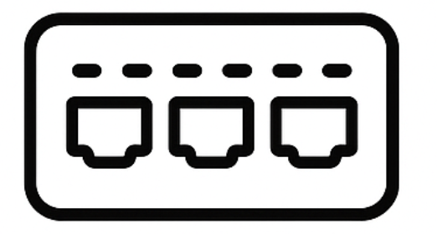
PCIe Switches Are Expensive, RDMA Is Limited
Option 1: PCIe Switches
Option 2: RDMA
Host
Host
Host
Host
PCIe Switch
RDMA
NIC
SSD
SSD
SSD
NIC
SSD
SSD
SSD
❌
Expensive to deploy
❌
Cannot pool NICs
(switches + switch software
+ host adapter cards + cabling)
= $80,000 per rack
❌
High latency overhead
and limited IOPS
Notes:
In fact, there are limited existing options to pool PCIe devices.
The first option is using PCIe switches.
Hosts and PCIe devices can both connect to PCIe switches, which allows hosts to access any device in the pool.
However, deploying PCIe switches is very expensive.
For example, deploying a PCIe switch for a rack requires purchasing the PCIe switch, the switch software, host adapter cards, and cabling, which can easily exceed 80,000 dollar for a single rack.
This high cost can easily outweigh the cost saving of pooling.
The other option is to let the host access remote PCIe devices over RDMA.
For example, many cloud providers offer remote SSDs over RDMA.
However, this approach assumes that each host has a NIC, which means it does not support NIC pooling.
In addition, RDMA incurs high latency overhead especially at the tail.
None of the existing options to pool PCIe devices is practical.
Before showing our solution to pool PCIe devices, let me give some quick background on pooling memory.

Slide 9
CXL to Pool Memory for Memory Utilization
Host A
Host B
Host C
Host D
Notes:
Compute Express Link, or CXL, standardizes memory transaction over PCIe links.
It has been shown that CXL can improve memory utilization by pooling memory across multiple hosts.
Instead of provisioning a fixed amount of memory for each host, CXL allows hosts to connect to a pool of memory through CXL links.
Host can dynamically allocate memory from the CXL memory pool based on their demand.

Slide 10
CXL to Pool Memory for Memory Utilization
Host A
CXL Memory Pool
Host B
Host A
CXL
Host B
CXL
Host C
Host D
CXL
CXL
Host C
Host D
Notes:
Compute Express Link, or CXL, standardizes memory transaction over PCIe links.
It has been shown that CXL can improve memory utilization by pooling memory across multiple hosts.
Instead of provisioning a fixed amount of memory for each host, CXL allows hosts to connect to a pool of memory through CXL links.
Host can dynamically allocate memory from the CXL memory pool based on their demand.

Slide 11
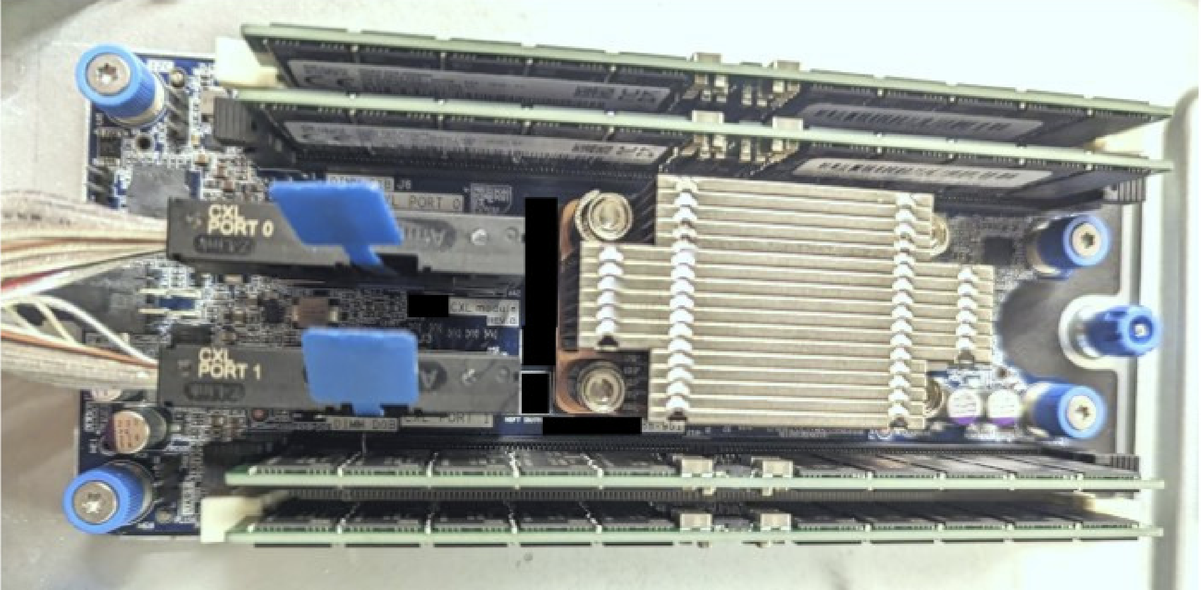
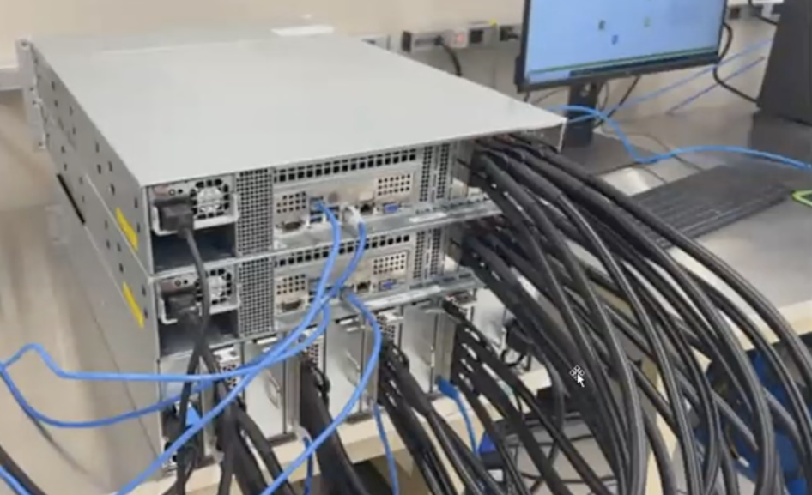
CXL Pools Pay Off in Memory Savings
Berger et al., Octopus: Scalable Low-Cost CXL Memory Pooling
Seagate; OCP Server - Composable Memory System call (Jun 28, 2024)
Port 0
Port 1
CXL device
2 CXL ports
4 CXL ports
Multi-port CXL devices enable low-cost memory pooling
CXL reduces server memory costs with small device costs
Li et al., Pond: CXL-Based Memory Pooling Systems for Cloud Platforms, ASPLOS ’23
Berger et al., Octopus: Scalable Low-Cost CXL Memory Pooling, Microsoft Technical Report
Notes:
Recent papers show that low-cost memory pools can be built using multi-port CXL devices, rather than using expansive CXL switches.
The photo on the left shows a CXL memory device with two ports. Each port can connect to a separate host.
Similarly, the photo on the right shows multiple 4-port CXL devices from Seagate.
Thanks to the low cost of multi-port CXL devices, memory pooling with CXL is *already* economically justified because the savings on server memory costs outweight the small device costs

Slide 12
CXL to Pool Memory
CXL to Pool Memory… and Now PCIe!
Host A
CXL Memory Pool
Host B
Memory Pool
(Allocated to individual hosts)
CXL
CXL
Shared Memory
CXL
CXL
Host C
Host D
Notes:
Our key insight is that: once CXL pools are deployed for memory pooling, they can also be used to pool PCIe devices!
To do that, besides the pooled memory which is allocated exclusively to each individual host, we can also allocate a small amount of CXL memory that is shared across multiple hosts.
All the hosts can access the shared memory region.

Slide 13
CXL to Pool Memory… and Now PCIe!
Host A
CXL Memory Pool
Host B
Memory Pool
(Allocated to individual hosts)
CXL
CXL
Shared Memory
CXL
CXL
NIC
SSD
Request Queue
NIC
SSD
Host C
Host D
Notes:
Let say we want to enable host A to use the NIC attached to host D.
To do that, we can allocate a request queue in the shared CXL memory region.
Host A can then post requests to the request queue, and the NIC at host D can poll from this queue and perform the requests.

Slide 14
Oasis: Pooling PCIe Devices Over CXL
Host A
CXL Memory Pool
Host B
Memory Pool
(Allocated to individual hosts)
CXL
CXL
Logical PCIe Pool
NIC
SSD
SSD
SSD
NIC
SSD
NIC
CXL
NIC
CXL
NIC
SSD
NIC
SSD
Host C
Host D
Notes:
In Oasis, we build a datapath over the shared CXL memory, which essentially *constructs a logical pool of PCIe devices across the hosts that connect to the same CXL memory pool*.
PCIe devices attached to any host can be used by any other hosts.

Slide 15
Oasis Benefits Utilization and Fault Tolerance
By pooling PCIe devices, Oasis enables:
✅ Higher utilization: Hosts share a smaller set of PCIe devices
✅ Fault tolerance: Hosts fail over to device on other hosts
Notes:
By pooling PCIe devices across hosts, Oasis enables higher PCIe device utilization by sharing a smaller set of PCIe devices across hosts. For example, we can provision NIC for only half of the hosts and share those NIC among all the hosts.
In addition, Oasis ensures PCIe device fault tolerence *without provisioning redundant devices*, because hosts can fail over to device on other hosts.
Next, I’ll talk about the design of the Oasis’s datapath.

Slide 16
Oasis’s Datapath Over CXL Pools
Host A
Shared CXL Memory
Host B
(1) Write payload
(6) DMA-read
PCIe
Application
Payload Buffer
CXL
CXL
Native Device
Driver (e.g., DPDK)
(2) Signal frontend
(5) Signal device
Frontend Driver
Backend Driver
Msg Channels
(3) Signal backend
(4) Poll messages
Notes:
Oasis’s datapath consists of three components:
the frontend driver, which exposes I/O interface to local applications
the backend driver, which runs on hosts with local PCIe devices, is used to forward I/O request and completion between the frontend driver and the PCIe device
the frontend driver and the backend driver communicates with each other using message channels over shared CXL memory
As an example, I’m going to show how the application can send a network packet using Oasis’s datapath.
First, the application writes the packet payload to a buffer in the shared CXL memory
It then signals the local frontend driver of the request.
The frontend driver then forwards the request to the corresponding backend driver through the message channel, along with the pointer to the payload buffer.
After the backend driver polled and received the request, it signals the NIC by invoking the native device driver, which is DPDK in this case.
When the NIC is about to send the packet, it issues an DMA to directly read the packet payload from the buffer in shared CXL memory.
Since we don’t need to copy packet payload to host local memory, the overhead incurred by Oasis is minimal.
*However*, I want to emphasize that implementing a performant message channels accessed by different hosts over shared CXL memory is challenging.

Slide 17
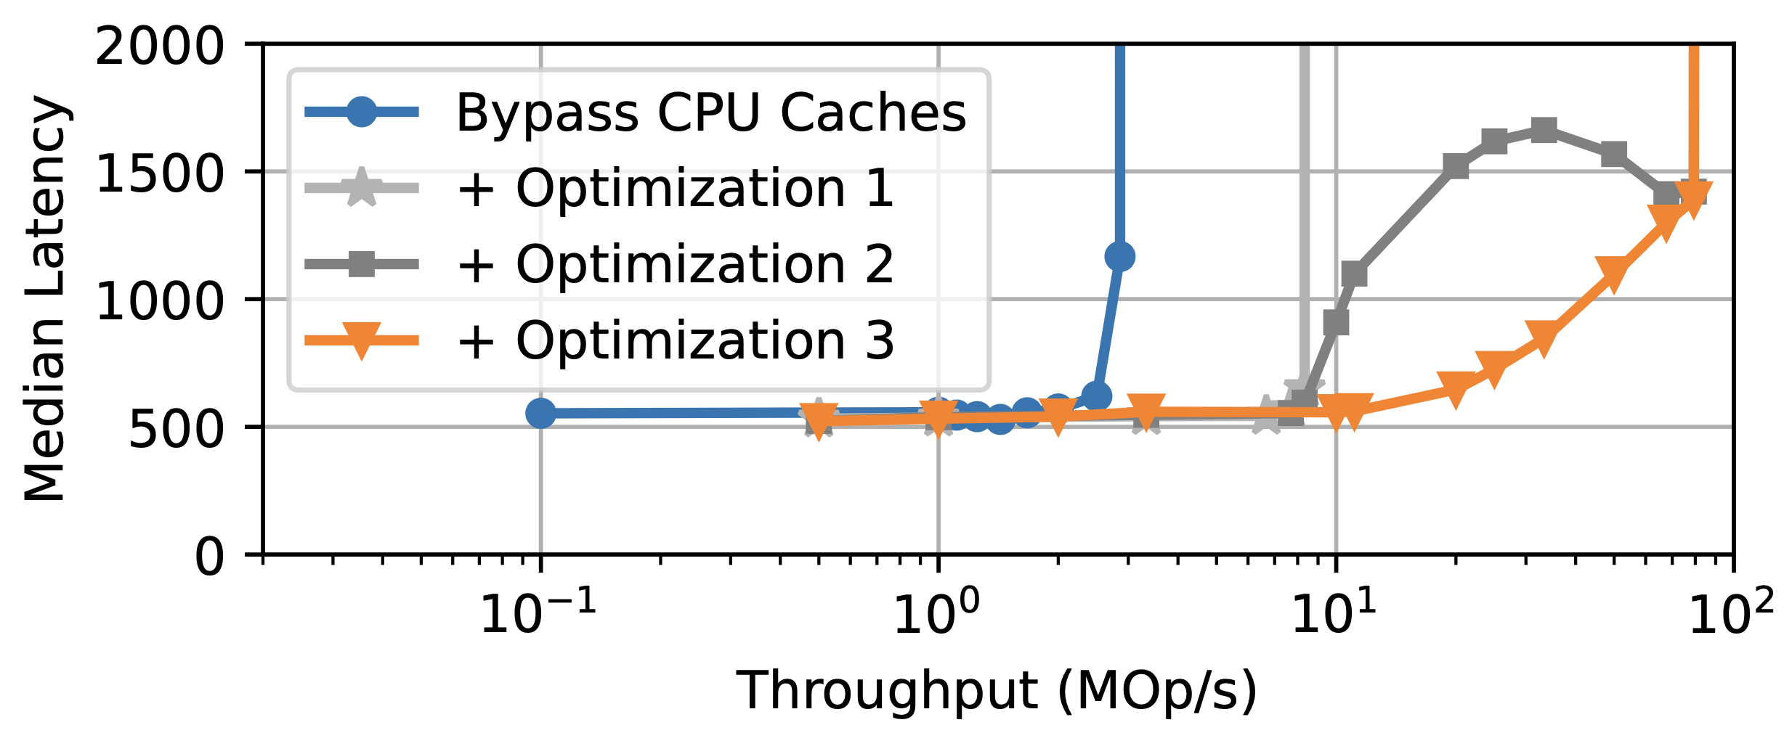
Challenge: Lack of Cache Coherence
⚠️ CXL pools today do not have cross-host cache coherence
✅ We design a message channel optimized for non-coherent shared CXL memory:
29×
(details in paper)
Notes:
This is because, the CXL memory devices available today *do not* support hardware cache coherence across hosts, because this feature requires expensive changes to both the CPU and the device.
Prior work overcome this challenge by bypassing CPU caches entirely. However, we find that such approach has poor performance because every memory access requires a cacheline flush.
In Oasis, we design a message channel that is optimized for non coherent shared CXL memory.
We employ several optimizations, which increases the message passing throughput by 29x comparing to bypassing CPU caches.
Please refer to our paper for details.

Slide 18
NIC Pooling Evaluation
What is the overhead of Oasis when pooling NICs?
Can Oasis fail over between NICs with minimal interruption?
Notes:
In the evaluation, we focus on two questions about NIC pooling:
...
Next, I’m going to talk about the hardware setup for NIC pooling

Slide 19
Baseline vs. Oasis: Host A ↔ Client Host
Baseline (Junction):
Host A
NIC
Network Switch
Client Host
NIC
Host B
NIC
Oasis (NIC pooling):
Host A
Network Switch
Client Host
CXL
NIC
Host B
NIC
Fried et al., Making Kernel Bypass Practical for the Cloud with Junction, NSDI ’24
Notes:
In our hardware setup, we have two hosts (host A, host B) and also a separate client host. The client host is used to drive network traffic.
In the baseline scenario, both host A and host B use their own NIC.
For example, when the client host sends a packet to host A, the packet will be routed to the NIC at host A.
In contrary, when using Oasis for NIC pooling, we let host A and host B share a single NIC located at host B.
Host A and host B connect to the same CXL memory pool.
Therefore, when the client host communicates with host A, the network traffic goes through the NIC at host B.

Slide 20
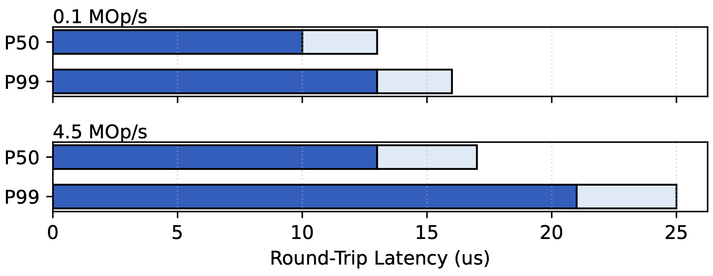
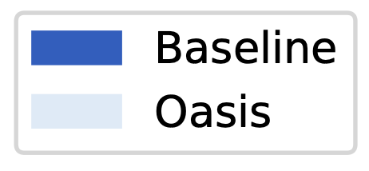
Oasis Incurs 3-4 μs Overhead
Workload: UDP packet echo between host A and client host
Modest 3-4 μs overhead compared to realistic datacenter network latency (50-100 μs)
Notes:
To understand the overhead of NIC pooling with Oasis, we run a UDP packet echo microbenchmark between host A and the client host.
We measure the round-trip latency at different throughput.
The P50 and P99 latency at different throughput are shown in this figure.
The results show that Oasis only incurs 3-4 us overhead on the round-trip latency.
Note that this overhead is modest given that typical round-trip network latency in datacenter is about 50-100 us.

Slide 21
Can Oasis Fail Over Between NICs?
NIC failed (injected by disabling switch port)
Host A
❌
NIC
Network Switch
NIC
Client Host
CXL
Host B
NIC
Oasis NIC failover
Host A
❌
NIC
Network Switch
NIC
Client Host
CXL
Host B
NIC
Notes:
Lastly, we show that Oasis enables NIC failover with minimal interruption
At the beginning, we let host A communicate with the client host using its own NIC.
We then inject NIC failure by disabling the switch port used by host A.
The NIC failure will trigger Oasis’s NIC failover, which reroutes the network traffic through the NIC at host B immediately

Slide 22
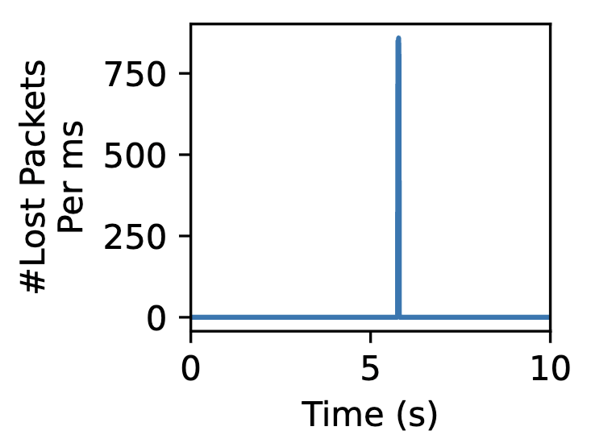
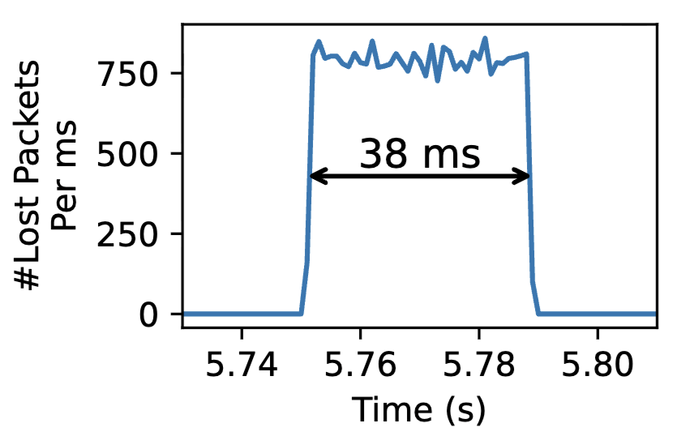
Oasis Fails Over Between NICs in 38 ms
Workload: UDP packet echo between host A and client host
NIC Failure
#Lost packets during the entire run
#Lost packets around failure moment
Notes:
This figure shows the number of lost packets during the entire run. The spike around the 5-th seconds is caused by the NIC failure. As we can see, Oasis minimizes interruption by rerouting the network traffic through another NIC.
The figure on the right shows the number of lost packets around the NIC failure moment. The results show that Oasis only takes 38 ms to finish NIC failover.
Without failover, a single NIC failure would make the entire host unreachable. Restarting applications on other hosts will take a few seconds at minimum.

Slide 23
Executive Summary
Pooling memory with CXL^{[1,2]}
Net memory cost savings despite minor CXL device costs
Memory
(25-50%)
Other
⚠️ Low util
Oasis: Pooling PCIe devices over CXL
Near-zero extra costs
TCO savings, higher utilization
PCIe fault tolerance
NIC & SSD
(20-40%)
✅
✅
⚠️ Low util
✅
CPU Server CapEx
✉️ yz@cs.columbia.edu
[1] Li et al., Pond: CXL-Based Memory Pooling Systems for Cloud Platforms, ASPLOS ’23
[2] Berger et al., Octopus: Scalable Low-Cost CXL Memory Pooling, Microsoft Technical Report
🌐 Link to code in the paper
Notes:
To give quick overview, both memory and PCIe devices such as NIC and SSD account for a large percentage of server CapEx, but they both have low utilization.
Prior shows that, by pooling memory across multiple servers with CXL, the server memory costs can be reduced despite the minor CXL device costs.
In this work, we argue that, the same CXL investment for memory pooling can unlock PCIe device pooling at *near-zero extra cost*
We build Oasis, the first system to pool PCIe devices across servers over CXL memory pools.
Oasis delivers immediate TCO savings and higher PCIe utilization
(mention failure tolerance)

